Slide 1
Identifying and reducing sexual harassment in stem
Dr. Matthew Paolucci Callahan, Psychology
Dr. Sarah Eagan, Psychology
Dr. Lynn Cominsky, Physics and Astronomy

Slide 2
Learning outcomes
1. Identify and describe the three forms of sexual harassment and recognize them in examples. – Sexual Coercion, Unwanted Sexual Attention, Gender Harassment.
2. Recognize and respond to factors that foster sexual harassment in STEM
1. STEM being male-dominated
2. Everyday sexism
3. Blurry boundaries

Slide 3
Understanding and recognizing sexual harassment

Slide 4
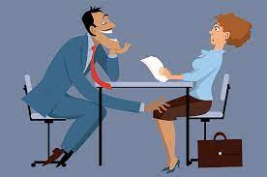
What is Sexual Harassment?
Sexual harassment is defined by its IMPACT, not its intent.
Examples
Sexually explicit jokes, emails, or texts
Inappropriate statements, lewd gestures
Unwelcome advances
Verbal or physical harassment
Anyone of any sex, sexual orientation, or gender identity can be a victim or a harasser
Notes:
Sexual harassment is defined by its impact, not its intent. It can include behavior such as unwelcome sexual advances, requests for sexual favors, and other verbal or physical harassment of a sexual nature. It can also include inappropriate statements; lewd gestures; leering behavior; sexually explicit jokes, emails, or texts; and offensive objects or images. Anyone of any sex, sexual orientation, or gender identity can be a victim or a harasser. The victim and the harasser can also be of the same sex, sexual orientation, and/or gender identity

Slide 5
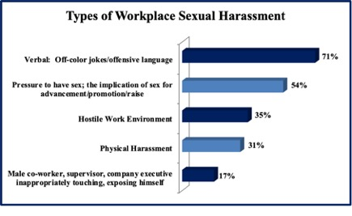
It is Prevalent. What is the most common expresison of it?
*Based on a sample size of 857 women, representing 57% of survey respondents who claimed they had experienced workplace sexual harassment. Source: ITIC 2021 Sexual Harassment, Gender Bias and Unequal Pay in STEM
Notes:
When it comes to sexual harassment and sexual assault in science, the evidence is clear. Seventy-one percent of women field researchers have received inappropriate sexual remarks and 26 percent reported experiencing sexual assault. In the field of astronomy, 40 percent of women of color report feeling unsafe in their workplace as a result of their gender and 28 percent as a result of their race. In the last two years alone, high profile cases of sexual violence have been reported in astronomy, biology, entomology, linguistics, geology, immunology, paleoanthropology, and physics.
This culture drives women out of science. And despite our desire to be objective and neutral, the evidence is also clear that men often ignore the evidence of gender discrimination in our own ranks.
https://cacm.acm.org/news/256561-sexual-harassment-bias-against-women-persist-in-stem-professions/fulltext

Slide 6
How does Sexual Harassment manifest?
Three main forms of sexual harassment:
Sexual Coercion
Unwanted sexual attention
Gender harassment
Notes:
(Fitzgerald et al., 1988, 1995)

Slide 7
Sexual Coercion
Occurs in situations of power disparities
Examples
Sexual blackmail
Bribes or threats aimed at sexual cooperation
Notes:
In situations of power disparities (one person has power over another) and includes behaviors such as sexual blackmail, bribes, or threats aimed at receiving sexual cooperation.

Slide 8
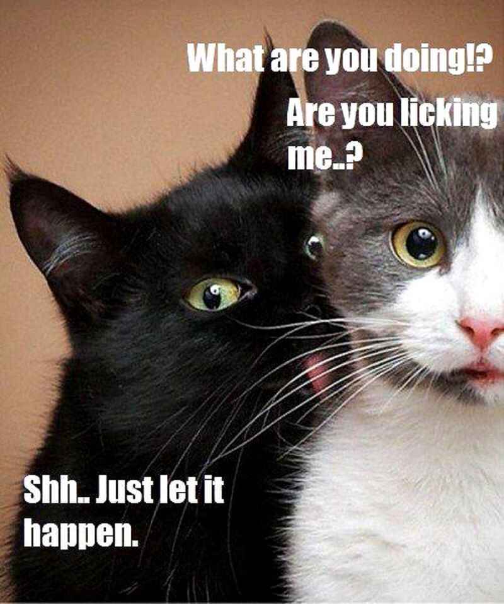
Unwanted Sexual Attention
Unwelcome, unsolicited, unreciprocated, and not ok!
Notes:
Unwelcome and unreciprocated gestures of sexual interest, such as an objectifying gaze, unwanted touching, or pressure for dates. (Unsolicted touch).

Slide 9
Gender Harassment – the entire environment disrespects and belittles women
Behaviors that belittle women and make them feel like they don’t belong.
Sexist hostility: More “put downs” than “come-ons”
Examples
Snide comments or remarks that persist even when asked to stop
Sexist jokes, anecdotes or stories
Labeling with an offensive nickname for their gender
Most widespread form of harassment
Faced gender harassment from her male colleagues
Notes:
https://www.science.org/content/article/rosalind-franklin-and-damage-gender-harassment
THIS TENDS TO GET LESS ATTENTION THAN THE TWO OTHER FORMS< BUT THIS IS BY FAR THE MOST COMMON FORM IN STEM AND ACADEMIA AS A WHOLE
And the literature supports that these everyday experiences may have as bad or worse personal and professional consequences as things like unwanted sexual advances."
Watson and Crick reveal the gender harassment that Franklin endured in the lab. Throughout The Double Helix, Watson's famous 1968 book recounting the race to the famous structure, Watson condescendingly refers to Franklin as "Rosy," a nickname never used to her face. "There was never lipstick to contrast with her straight black hair, while at the age of thirty-one her dresses showed all the imagination of English blue-stocking adolescents," he writes, though neglecting to critique his male colleagues' cosmetic or sartorial choices.
He adds that her "belligerent moods" interfered with Wilkins' ability to "maintain a dominant position that would allow him to think unhindered about DNA." For that reason, "[c]learly Rosy had to go or be put in her place. … The thought could not be avoided that the best home for a feminist was in another person's lab." In the 1993 book Nobel Prize Women in Science, Crick was quoted as saying, "I'm afraid we always used to adopt—let's say, a patronizing attitude towards her."
Inappropriate displays of material that offends a particular gender, e.g., an insulting comic or another type of graphic or visual content.
Comments or remarks, e.g., an inappropriate joke or story, that are directed as an affront to people of a specific gender.
Insults or derogatory actions directed at a person solely because of their gender.
Remarks that continue to be made even after the person has requested that they stop or the person targeted has indicated to the alleged harasser that they are offensive.
Actual physical contact, assault, or interference with the person based on hostility to an individual’s gender.
Labeling an individual with an offensive nickname for their gender.
Generalized sexist slurs.
Obscene humor or jokes about sex or any gender in general.
Degrading anecdotes.
Nicknames that are derogatory of a person’s gender.
Gender-based belittling of a person or patronizing comments about them.

Slide 10
Let’s Practice! Which form of sexual harassment is this?
During an exam, a female student raises her hand with a question. The male professor leans over her, puts his arm around her and lightly brushes her back while answering her question.
Unwanted sexual attention
(note – the (now former) professor in this situation said that he was just a “touchy feely type of guy with everyone”. (just not the guys)

Slide 11
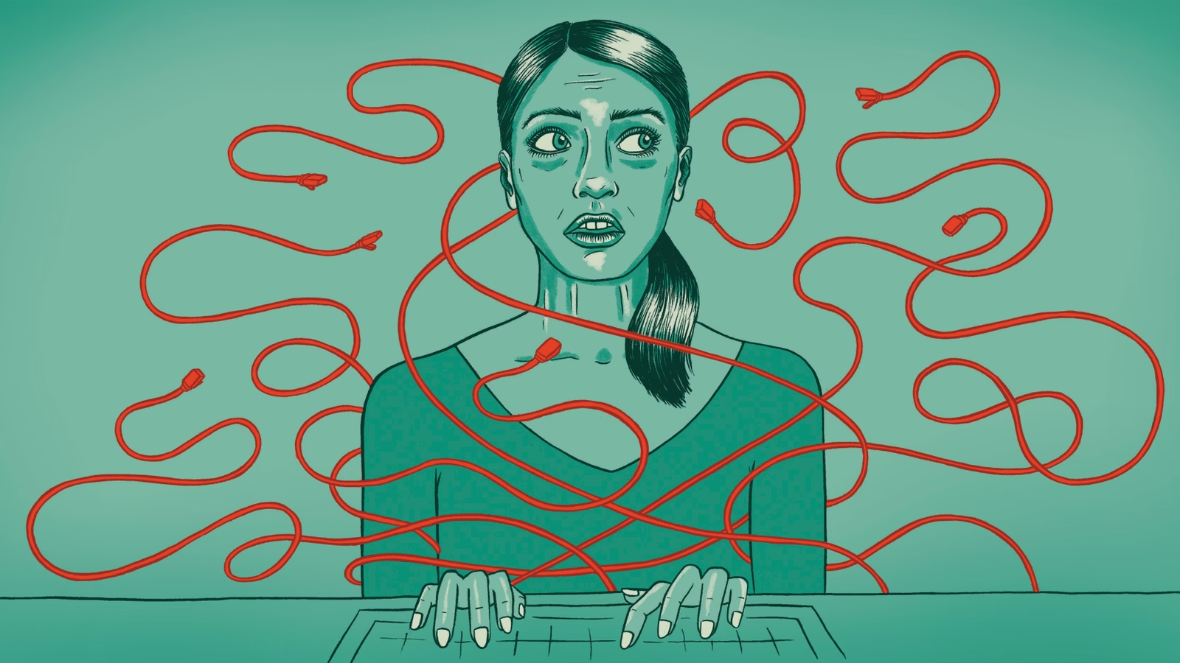
Overall Impact: it impacts every sphere of life
Family impacted
Devaluation of self

Slide 12
Why does this all happen? Why is sexual harassment such a problem in STEM fields?
1. STEM disciplines are male-dominated
2. STEM as spaces for everyday sexism
3. Blurry boundaries

Slide 13
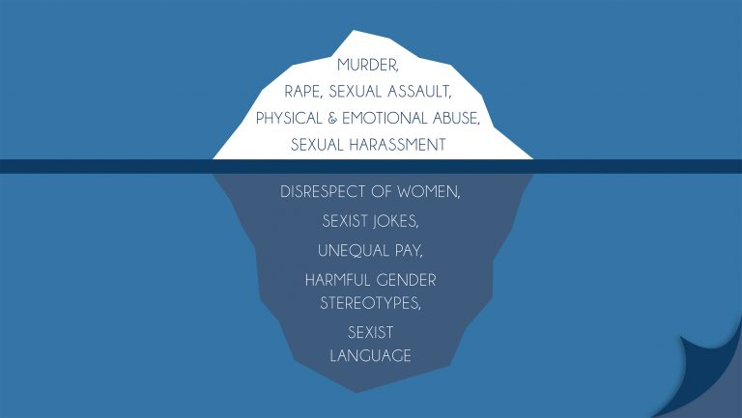
What’s Under the Surface?
Sexual harassment doesn’t just spring up from nowhere. And this is where you can have the most influence to make things better!

Slide 14
1. STEM disciplines are disproportionately comprised of men
Why might this be a problem?
When one group outnumbers another in a given space, stereotypes of the outnumbered group tend to be activated
Notes:
WHY MANY LEAVE
ADD EXAMPLES FRM SHANNON AND OTHERS.

Slide 15
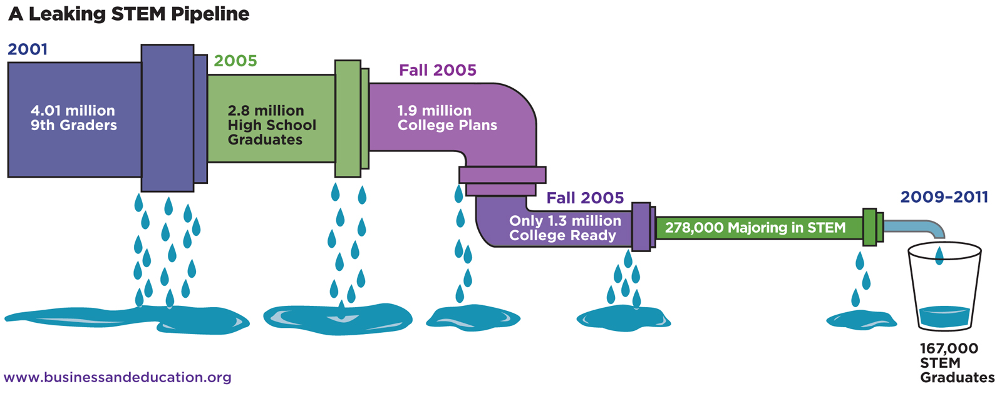
Why does STEM have fewer women than men?
Men still outnumber women (leaky pipeline)

Slide 16
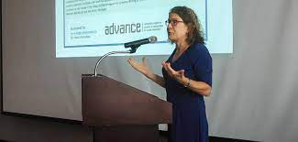
STEM as “a boys’ club”
Boys club – a male dominated field or organization that excludes or mistreats women
Notes:
ADD HER EXAMPLES

Slide 17
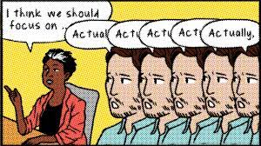
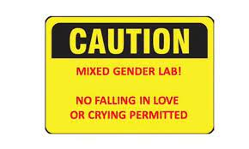
Everyday Sexism
Everyday Sexism
Minor to moderate (but still irritating) instances of sexism that add up. (think gender harassment
¨
Examples
Objectification – Persistent focus on women’s their appearance versus their work
Interrupting women when they are speaking
Assuming they have (or should have kids)
Misattributing ideas to men
Questioning a woman’s expertise (Mrs..)
Notes:
2020 longitudinal study across a semester found that women in STEM witnessed or experienced 1 to 2 sexist event per week.
Treatment of the female body specifically as an object of sexual desire by men
¨Treatment of the female body specifically as an object of sexual desire by men

Slide 18
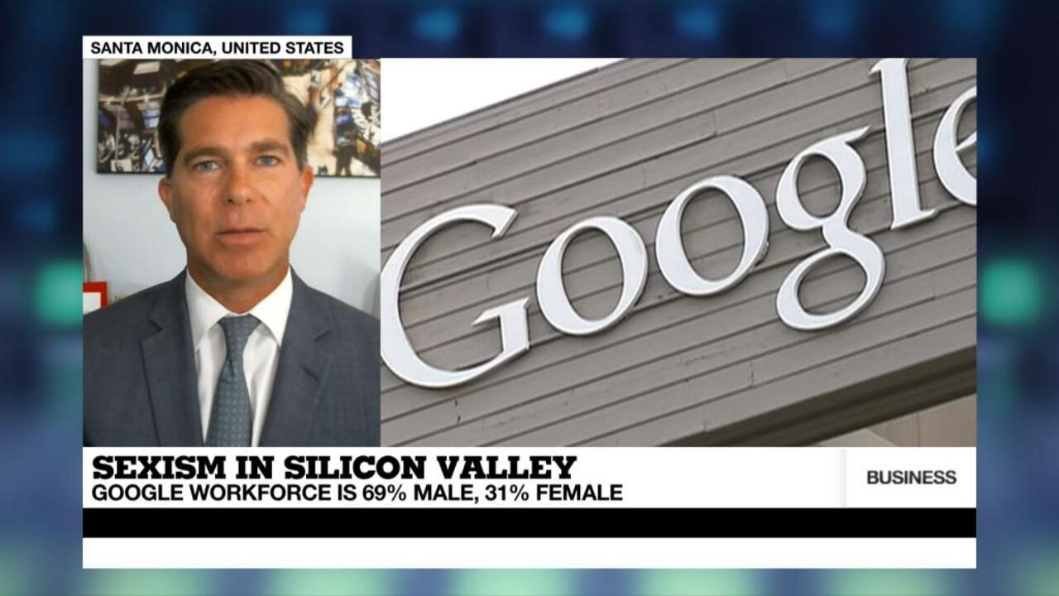
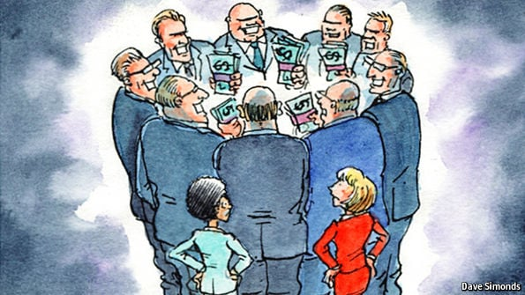
Everyday Sexism Examples

Slide 19
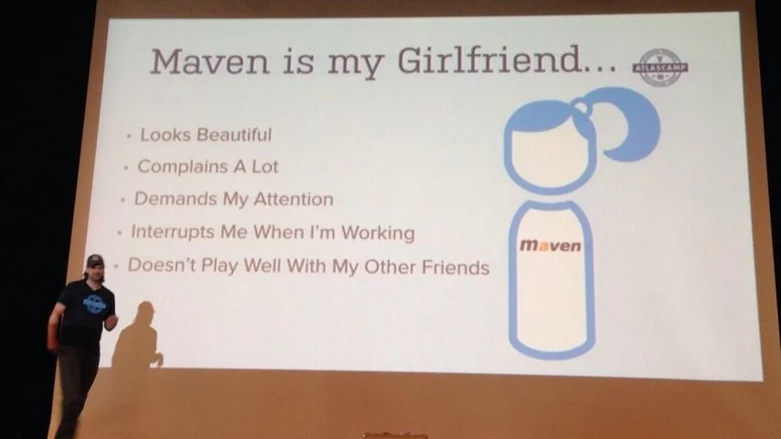
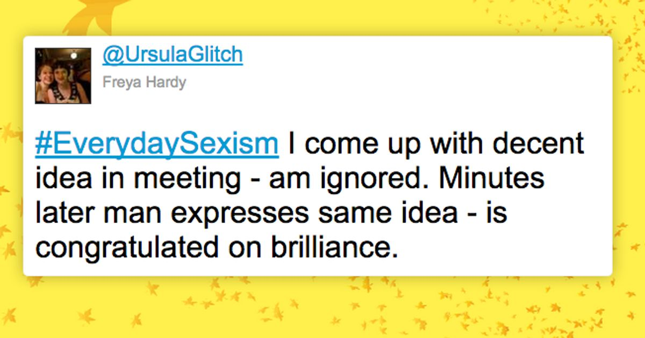
Everyday sexism examples
Notes:
The consequences of a dearth of women in technology are showing up again, this time in a show of sexism at a tech conference in Berlin. (See update at end of post.)
Atlassian, the company behind software products Jira, Confluence, HipChat and more, is holding its #AtlasCamp for developers, and a developer there took the stage to present. Business Insider details what went down:
"[Jonathan] Doklovic was making a presentation called, 'A P2 Plugin and a SaaS Platform Walk into a Bar ...' In the presentation, he threw up a slide about Maven, a plugin execution framework supported by Atlassian that developers can use to add software components to their existing applications.
"In the slide, Doklovic compared Maven to his girlfriend, saying that although she looks beautiful she 'complains a lot, demands my attention, interrupts me when I'm working' and 'doesn't play well with my other friends.' "
While the attendee who put up the photo, Marko Saha, says, "People attending locally #AtlasCamp seemed not to be offended," his photo of the slide was posted on Twitter. That stirred up the latest tempest of disgust on both sides of the Atlantic Ocean.

Slide 20
Everyday sexism examples
Notes:
When recalling the sexism of her former boss Ellen Pao states, "...her former boss John Doerr employed two chiefs of staff, one male and one female. The male employee primarily oversaw investing responsibilities and the female employee 'did more of the grunt work'… Pao recalls how Doerr once told her, "there are certain things I am just more comfortable asking a woman to do"
When she originally filed her lawsuit against her former employer (in 2012) on the basis of gender discrimination she notes that only one women in the 40 year history of the firm had ever been promoted senior partner
In 2015 trial Ellen Pao vs. Kleiner Perkins, Pao details an instance of unwanted sexual advance in which a senior partner at her work gave her book that contained sexual drawings and poems containing sexual content, in it was a handwritten note. Around the same time the same senior partner asked her to go out to dinner with him insisting that his wife was out of town. She also details an instance traveling on a plane to New York with other male colleagues who proceeded to have an offensive sexual conversation in front of her ("bro talk").

Slide 21
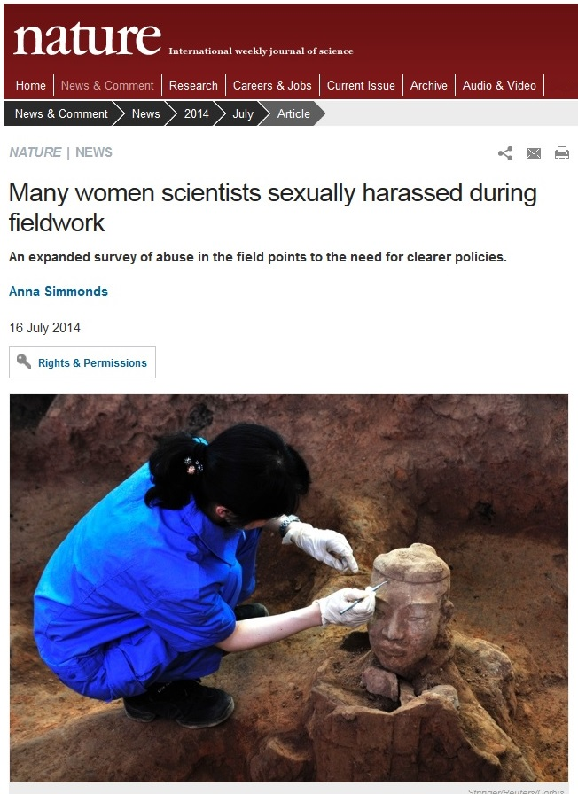
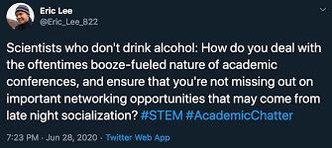
Blurry professional boundaries foster the potential sexual harassment
Examples –
Professional conferences
Social events/lab parties
Anything off campus (work trips)
Anywhere that alcohol is present
Notes:
https://www.science.org/content/article/sexual-harassment-common-scientific-fieldwork

Slide 22
Blurry boundaries = potential sexual harassment
What can you do?
Remind yourself – We’re at work
If possible, redirect colleagues who are being inappropriate
If conversation strays to the inappropriate, introduce a new topic
If you see something, say something to someone who can help
Notes:
https://www.science.org/content/article/sexual-harassment-common-scientific-fieldwork

Slide 23
You just learned -
1. To identify and describe the three forms of sexual harassment and recognize them in examples. – Sexual Coercion, Unwanted Sexual Attention, Gender Harassment.
2. To recognize and respond to factors that foster sexual harassment in STEM
1. STEM being male-dominated
2. Everyday sexism
3. Blurry boundaries

